Slide 1
Forgiveness
Matthew 6:12-15

Slide 2
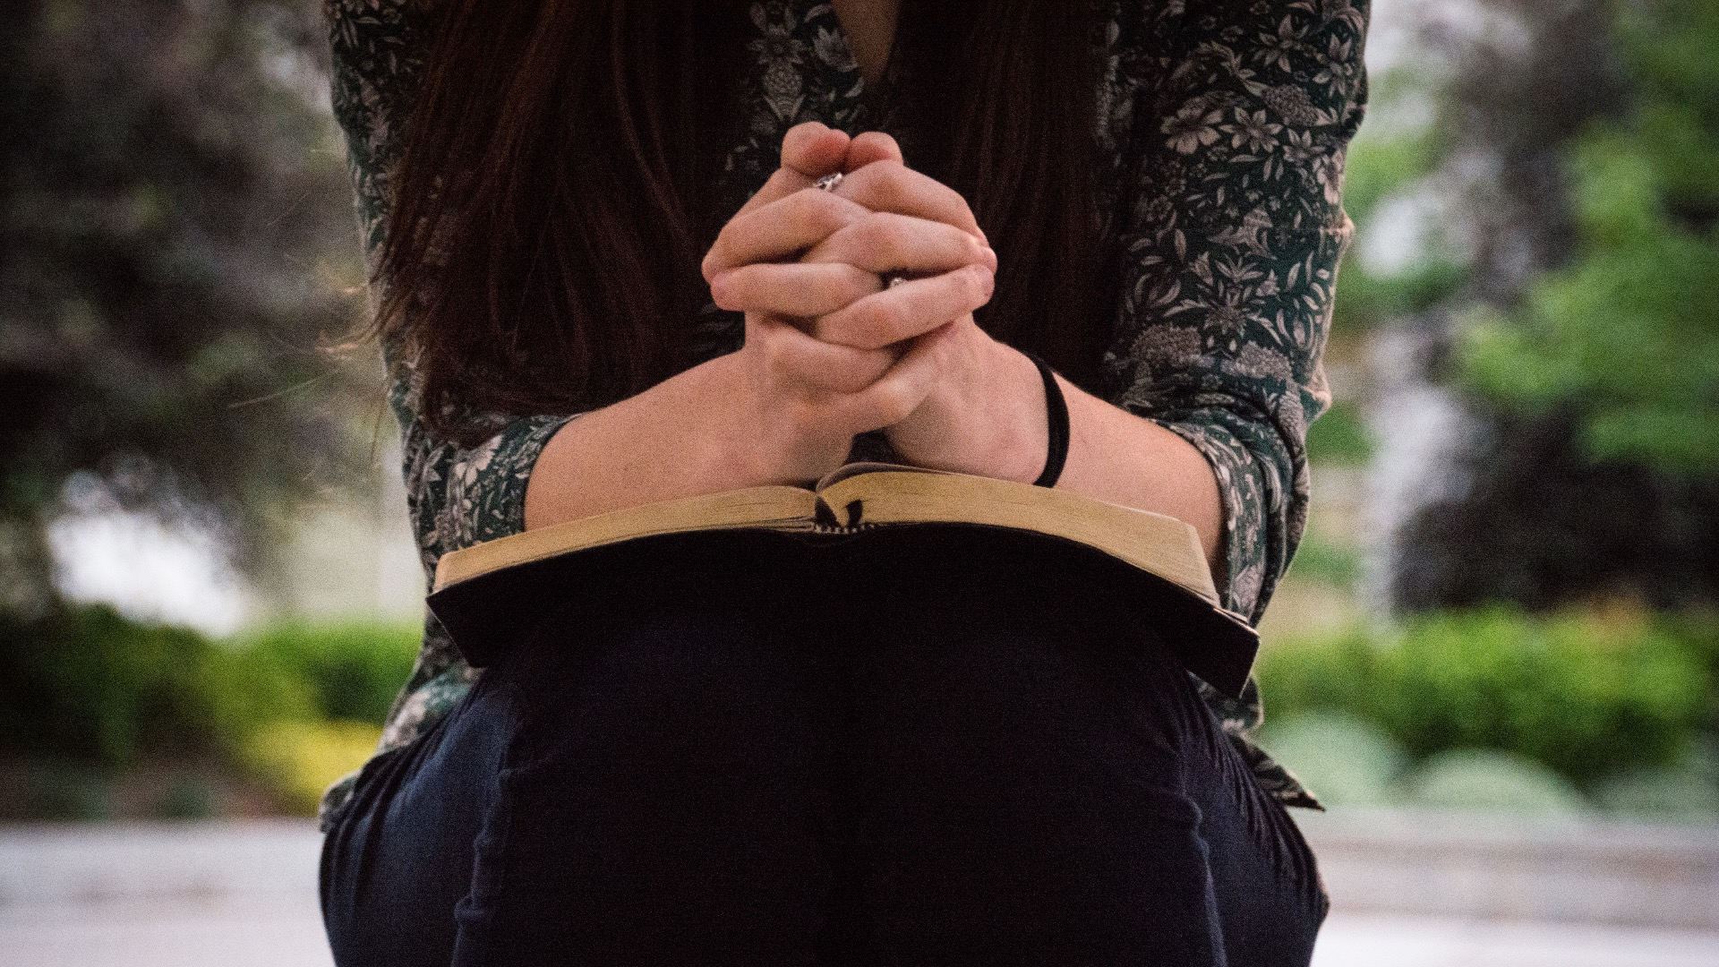
Matthew 6:12
Forgive us the wrong we have done, As we have forgiven those who have wronged us.

Slide 3
Matthew 6:14-15
For if you forgive others the wrongs they have done, your heavenly Father will forgive you; but if you do not forgive others, the the wrongs you have done will not be forgiven by your heavenly Father

Slide 4
John 3:36
He who believes in the Son has eternal life. But whoever rejects the Son will not see life, for the wrath of God remains on him.

Slide 5
Psalm 103:8-14
The Lord is compassionate and gracious, Slow to anger and abounding in love. He will not always accuse nor will He harbour his anger forever; he does not treat us as our sins deserve or repay us according to our iniquities. For as high as the heavens are above the earth, so great is his love for those who fear him;

Slide 6
Psalm 103:8-14
As far as the east is from the west, so far has he removed our transgressions from us. As a father has compassion on his children, so the Lord has compassion on those who fear him; for he knows how we are formed; he remembers that we are dust.

Slide 7
2 Samuel 12:5
David burned with anger against the man and said to Nathan, “As surely as the Lord lives, the man who did this deserves to die! He must pay for that lamb four times over because he did such a thing and had no pity.”

Slide 8
2 Samuel 12:13
“I have sinned against the Lord.” “He has taken away your sin. You will not die.”

Slide 9
Matthew 18:15-17
If your brother sins against you, go and show him his fault, just between the two of you. If he listens to you, you have won your brother over. But if he will not listen, take one or two others along so that ‘every matter may be established by the testimony of two or three witnesses.’ If he refuses to listen to them, tell it to the church; and if he refuses to listen even to the church, treat him as a pagan or a tax collector.

Slide 10
Luke 17:3-4
“If your brother sins, rebuke him, and if he repents, forgive him. If he sins against you 7 times in a day, and 7 times comes back to you and says, ‘I repent’, forgive him.”

Slide 11
Luke 24:45-47
Then he opened their minds so they could understand the scriptures. He told them, “This is what is written: The Christ will suffer and rise from the dead on the third day, and repentance and forgiveness of sins will be preached in his name to all nations, beginning at Jerusalem.”

Slide 12
2 Chronicles 33:12-13
In his distress he sought the favour of the Lord his God and humbled himself greatly before the God of his fathers. And when he prayed to him, the Lord was moved by his entreaty and listened to his plea. So he brought him back to Jerusalem and to his kingdom. Then Manassa knew that the Lord is God.

Slide 13
Corrie Ten Boom
“Forgiveness is the key that unlocks the door of resentment and the handcuffs of hatred. It is a power that breaks the chains of resentment and the shackles of selfishness.”

